Slide 1






Content-Aware Texturing for Gaussian Splatting
Panagiotis Papantonakis^{1,2}, Georgios Kopanas^{3,4*}, Frédo Durand⁵, George Drettakis^{1,2}
1 INRIA, 2 Université Côte D’Azur, 3 Google, 4 RunwayML, 5 MIT CSAIL
*Work done at Google
1
2
3
4
5

Slide 2
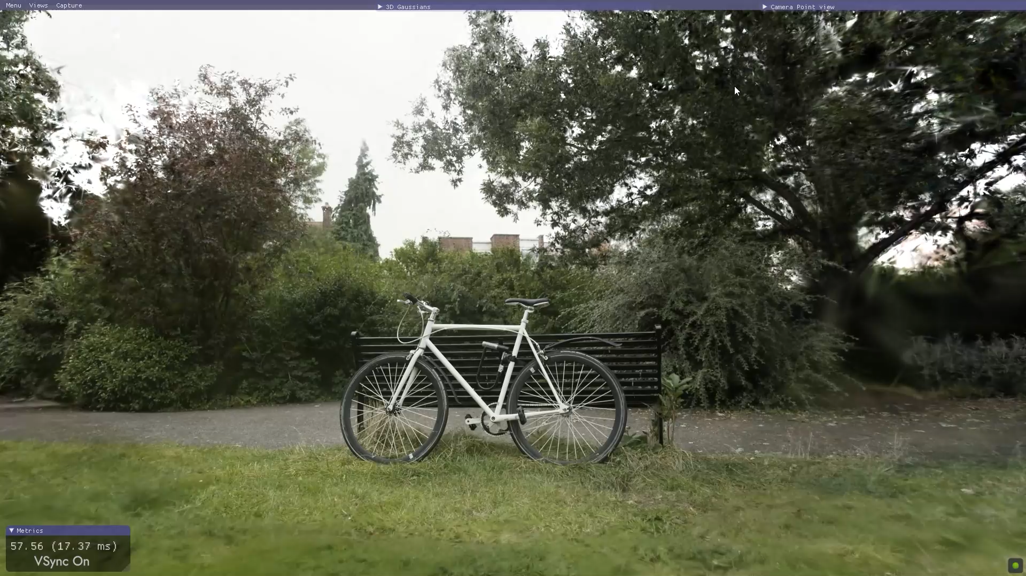
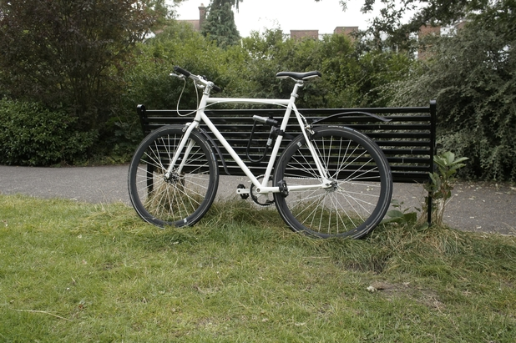

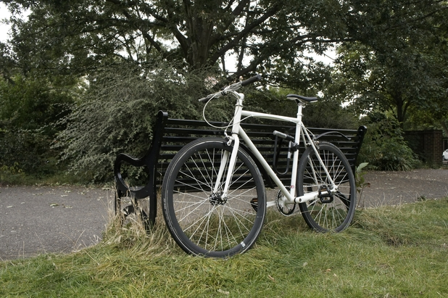

Background – 3D Gaussian Splatting
Per primitive parameters
position
scales
rotation
opacity
view dependent color
Geometry
Appearance
$$Loss( ,g.t.\text{)}$$
Optimization
[Kerbl B. et al. 2023] 3D Gaussian Splatting for Real-Time Radiance Field Rendering
Notes:
Our work falls under the domain of Novel View Synthesis in which 3D Gaussian Splatting is a prominent, state-of-the-art solution.
In this method, the scene is represented by a set of 3D Gaussian primitives, with parameters controlling their position, shape and view-dependent appearance.
A differentiable rasterization algorithm alpha blends the colors of the primitives to render an image, which is then compared to the ground truth.
Since this process is differentiable, gradients flow back to the primitives, adjusting them to better reconstruct the scene
The result is a system where, given some input images of a scene, an optimization process results in a reconstruction of the scene, allowing for free viewpoint navigation.

Slide 3
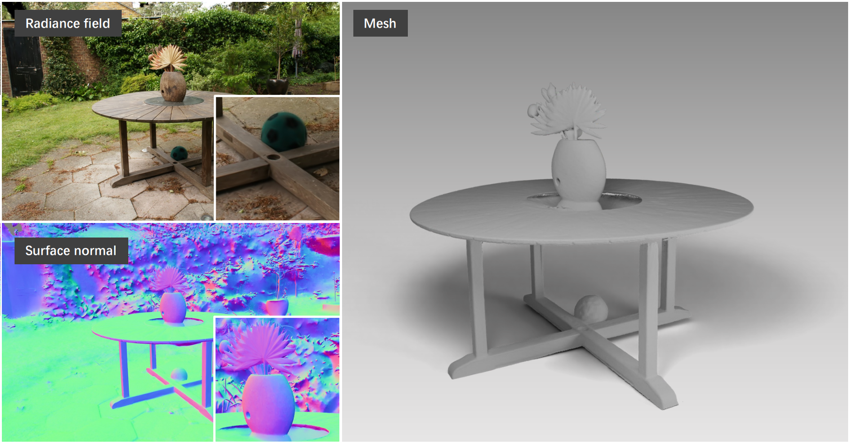
Background – 2D Gaussian Splatting
3D Gaussian Primitives ⇨ 2D Gaussian Planar Ellipses
3D Rotation ⇨ 2D Rotation + Normal
[Huang B. et al. 2024] 2DGS: 2D Gaussian Splatting for Geometrically Accurate Radiance Fields
Notes:
Our work is based on 2DGS, a variant of 3DGS, that improves the reconstruction of geometry.
The main difference is that, as its name suggests, 2DGS uses 2D gaussian planar primitives, each of which has an explicitly defined normal,

Slide 4
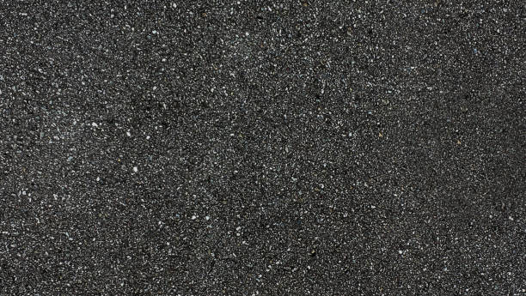
Problem Statement
1 geometric sample
1 color sample
Notes:
Now, a common property for almost all Gaussian Splatting methods out there is that they use 1 view-dependent colour per primitive.
This means that the sampling rate for geometry and appearance is tied.
So, in regions with high-frequency appearance gaussian splatting cannot help but spawn a lot of primitives to reconstruct it.
This, however, can be disadvantageous if the underlying geometry is simple, as the overhead from the geometric parameters ends up being a waste of the model capacity.

Slide 5
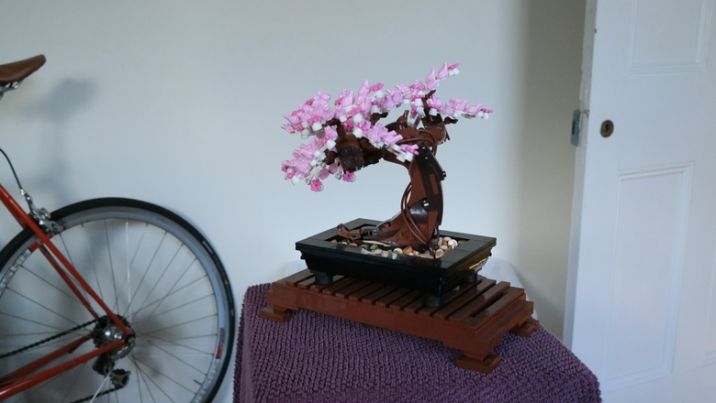
Problem Statement
Varied degree of complexity across the scene
Low-frequency
High-frequency
Notes:
Of course, in reality, our scenes have a varied degree of complexity, from low frequency areas, like the wall in this example,
to high frequency ones, like the cloth on the table top

Slide 6
Problem Statement – Goals
2DGS
1 geometric sample
N color sample
N associated to scene content
Complex appearance High N
Simple appearance Low N
Good use of model capacity
No increase in model size (#parameters used)
Scale-independent per-primitive texture maps
Adaptive Texel Size
Primitive Splitting
Notes:
So, our goals for this project is to create a representation that allows an 1-N ratio between geometry and appearance
We also want this N to be adaptive to the scene content, with high N assigned for regions with complex appearance and low N for regions with simple appearance.
And of course, we want to make good use of model capacity and don’t increase the overall size too much
For that reason, we extend the 2DGS representation to use scale-independent per-primitive textures maps and we develop strategies to adaptively change the texel size and split primitives

Slide 7
Related Work
Notes:
Before going on to how our method works, let’s see some related work.

Slide 8
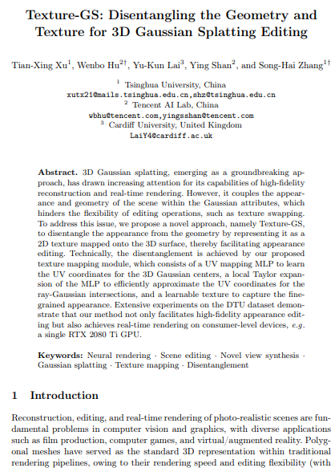
Related Work – UV Mapping
Learned UV mapping between primitives and texture atlas
Disentanglement of geometry and appearance
Texture space definition restricts it to single objects
U,V
Notes:
In this work from 2024, the authors proposed a way to learn UV coordinates for each primitive to a common, learned, texture atlas.
Even though this method provides a nice disentanglement of the geometry and appearance for 3DGS,
it is restricted to single objects, because the texture space is defined as a unit sphere, which cannot accommodate multiple objects or entire scenes,

Slide 9
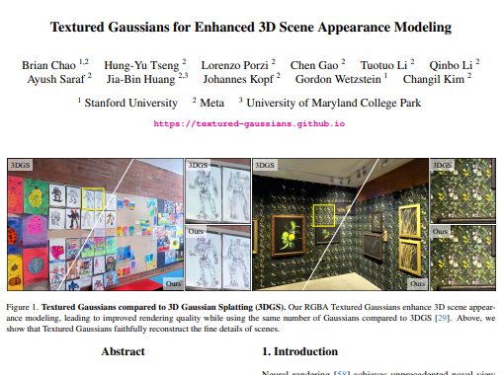
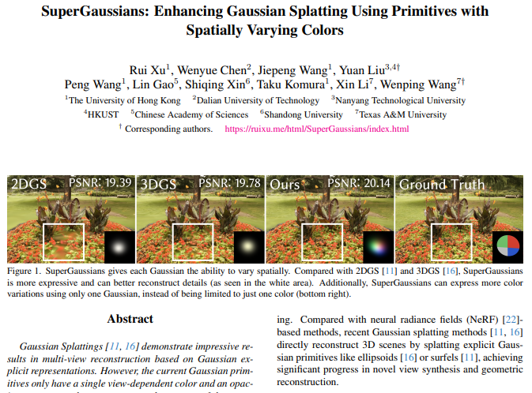
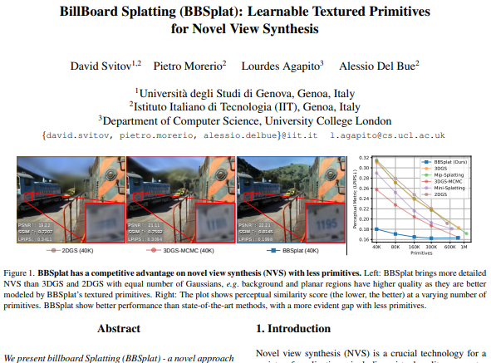
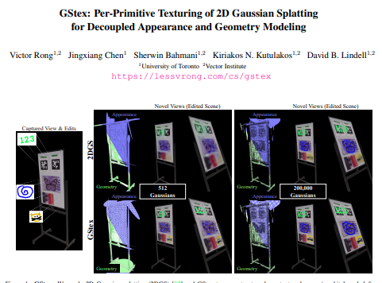
Related Work – Per-primitive Texture
Per-primitive RGB(A) textures
Support of entire scenes
Improve in quality
Increased #parameters
Texel budget allocation not scene-informed
Pretrained models for reconstruction of geometry
Notes:
Closer to our work, there are several, published and preprint works that propose the use of per-primitive RGB and optionally A textures, that improve the quality of novel view synthesis over the baseline.
However, all of these works come together with an increase in the number of parameters used, leading to bigger and more resource hungry models,
Also, in these methods, the way the colour samples are distributed over the primitives in not scene-informed, resulting in a use of model capacity that does not adapt to the scene
And finally, some of them require a converged model as initialization for geometry, which is not necessarily compatible to the multi coloured representation

Slide 10
Methodology
Notes:
Moving on to our work

Slide 11
Methodology – Texture Definition in Canonical Space
world space
world space centered
local axis-aligned
gaussian canonical space
Subtract primitive’s center
Notes:
First step is to define the texture.
For that, we need to play a bit with coordinate systems.
As said before, we use flat 2DGS primitives, that live in the world space
Subtracting the primitive’s center moves the origin of the system to the primitive(click)

Slide 12
Methodology – Texture Definition in Canonical Space
world space
world space centered
local axis-aligned
gaussian canonical space
Inverse primitive’s rotation
Notes:
Then (click), inversing the primitive’s rotation aligns the system’s axes with the primitive’s axes.
Since our primitive are flat, (click) we can drop the third dimension
Finally, normalizing by the primitive’s scales moves us to the gaussian canonical space

Slide 13
Methodology – Texture Definition in Canonical Space
world space
world space centered
local axis-aligned
gaussian canonical space
Normalize with primitive’s
scales
Notes:
While inversing the primitive’s rotation aligns the system’s axes with the primitive’s axes.
Since our primitive are flat, (click) we can drop the third dimension
Finally, normalizing by the primitive’s scales brings us to the gaussian canonical space

Slide 14

Methodology – Texture Definition in Canonical Space
world space
world space centered
local axis-aligned
gaussian canonical space
Notes:
Finally (click), normalizing by the primitive’s scales moves us to the gaussian canonical space where the isocontours of the gaussian function are circles

Slide 15
Methodology – Texture Definition in Canonical Space
world space
world space centered
local axis-aligned
gaussian canonical space
Notes:
Defining the texture here is a viable option, which has the benefit of ensuring a fixed texture resolution and a straightforward implementation.
However, moving back to world space, we see that the texture is scaled together with the primitive, resulting in stretched texels

Slide 16
Methodology – Texture Definition in Canonical Space
world space
world space centered
local axis-aligned
gaussian canonical space
Texture stretching!
Notes:
Defining the texture here is a viable option, which has the benefit of ensuring a fixed texture resolution and a straightforward implementation.
However, moving back to world space, we see that the texture is scaled together with the primitive, resulting in stretched texels

Slide 17
Methodology – Texture Definition in Canonical Space
world space
world space centered
local axis-aligned
gaussian canonical space
Texture stretching!
Notes:
Defining the texture here is a viable option, which has the benefit of ensuring a fixed texture resolution and a straightforward implementation.
However, moving back to world space, we see that the texture is scaled together with the primitive, resulting in stretched texels
This consists a major issue for the optimization, because, as our primitives grow or shrink to match the underlying geometry,

Slide 18
Methodology – Texture Definition in Canonical Space
world space
world space centered
local axis-aligned
gaussian canonical space
Texture stretching!
Notes:
Defining the texture here is a viable option, which has the benefit of ensuring a fixed texture resolution and a straightforward implementation.
However, moving back to world space, we see that the texture is scaled together with the primitive, resulting in stretched texels
This consists a major issue for the optimization, because, as our primitives grow or shrink to match the underlying geometry,
the scale of details that their textures can represent changes!
To make it more clear, if this primitive was to grow even more
Its appearance would become even coarser and therefore it can now not capture the same details as before

Slide 19
Methodology – Texture Definition in Canonical Space
world space
world space centered
local axis-aligned
gaussian canonical space
Texture stretching!
Notes:
This consists a major issue for the optimization, because, as our primitives grow or shrink to match the underlying geometry,
the scale of details that their textures can represent changes!
To make it more clear, if this primitive was to grow even more
Its appearance would become even coarser and therefore it can now not capture the same details as before

Slide 20
Methodology – Scale-Independent Textures
world space
world space centered
local axis-aligned
gaussian canonical space
Scale-independent
Notes:
To avoid that, we define our textures in the local, axis aligned space.
Doing that, has the benefit of textures that are independent of scale

Slide 21
Methodology – Scale-Independent Textures
world space
world space centered
local axis-aligned
gaussian canonical space
Scale-independent
Notes:
To avoid that, we define our textures in the local, axis aligned space.
Doing that, has the benefit of textures that are independent of scale

Slide 22
Methodology – Scale-Independent Textures
world space
world space centered
local axis-aligned
gaussian canonical space
Scale-independent
Notes:
To avoid that, we define our textures in the local, axis aligned space.
Doing that, has the benefit of textures that are independent of scale
When a primitive grows or shrinks, it just observes more or fewer of same sized texels
as shown here

Slide 23
Methodology – Scale-Independent Textures
world space
world space centered
local axis-aligned
gaussian canonical space
Scale-independent
Notes:
as shown here

Slide 24
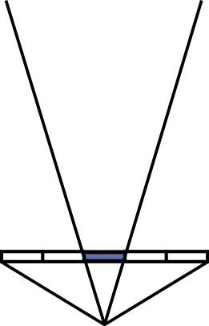
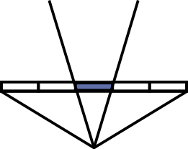
Methodology – Texture Definition in Axis-Aligned Space
Texels dynamically added/removed to cover rendered area
Variable texture resolution
Fixed texel size k_{min} in world space
Conservative choice
Minimum backprojected pixel size
Notes:
So, summing up, by defining our textures that way, we don’t have a fixed texture resolution.
Texels need to dynamically be added or removed as the size of the primitive changes
Our textures do have though a fixed texel size in world space.
For each primitive, we choose that in a conservative way as the width of a pixel, backprojected to world space from the closest camera to avoid strong aliasing artifacts

Slide 25
Methodology – Texture Definition in Axis-Aligned Space
Texels dynamically added/removed to cover rendered area
Variable texture resolution
Fixed texel size k_{min} in world space
Conservative choice
Minimum backprojected pixel size
Notes:
In this toy scene, this primitive would have a texel size equal to the length of the orange bar

Slide 26
Methodology – Texture Definition in Axis-Aligned Space
Texels dynamically added/removed to cover rendered area
Variable texture resolution
Fixed texel size k_{min} in world space
Conservative choice
Minimum backprojected pixel size
color = view-dependent color + B-INTERP (texel values)
Notes:
Finally, the textures are added to the primitives view-dependent color, by bilinearly interpolating their texel values.
Note that both the view-dependent color and the texture values will be attenuated by the gaussian falloff during rendering.

Slide 27

Methodology – Adaptive Texel Size
k = t • k_{min} , t = 1, 2, 4, 8…
t = 1
t = 2
t = 4
k
k
k
Notes:
As we said before, we want our representation to make good use of model capacity and assign colour samples where it is needed, based on scene content.
To enable that, we extend the texel size definition with a scalar parameter t that controls how coarse or fine our textures are.
A low number means a fine texture, while a greater one results in coarser appearance.
We have developed an upscaling and downscaling strategies to change this scalar parameter during optimization.

Slide 28
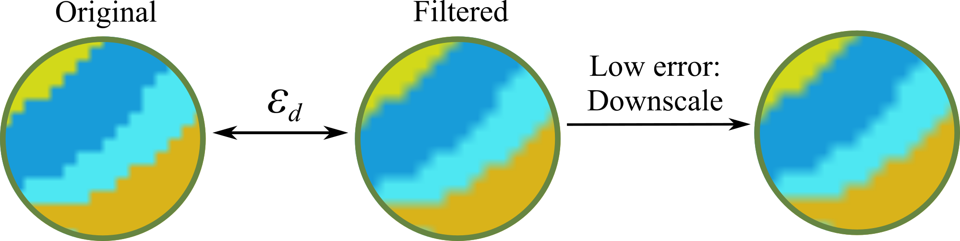
Methodology – Adaptive Texel Size – Downscaling
t ↑
k
k
k
Notes:
Regarding downscaling, things are simple.
We want to downscale textures that have a coarse appearance and therefore don’t need a lot of color samples.
To do that, we pass the textures through a low pass filter and compute a per texel loss between the filtered and the original version.
If this is less than a threshold, we proceed into increasing the parameter t, essentially using the filtered version

Slide 29
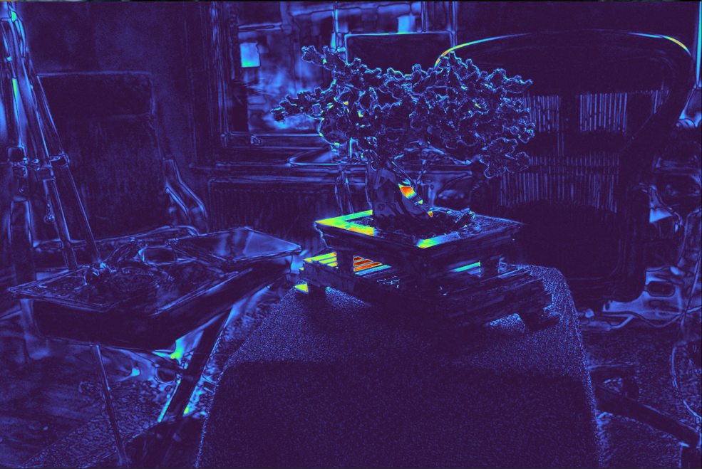
Methodology – Adaptive Texel Size – Upscale
high error = need for more
color samples
E_{i}
E_{i}¹
E_{i}⁰
E_{i}¹
E_{i}⁰
[Rota Bulò S. et al. 2024] Revising Densification in Gaussian Splatting
Notes:
Things are a bit more involved with upscaling.
We assume that primitives require more color samples when they don’t fit the scene correctly.
We quantify that using a reconstruction error inspired by Revising Densification in Gaussian Splatting.
(click) This error aggregates the RGB error from the training images and (click) distributes them to the primitives.
So we end up with one error value per primitive.
Primitives with a high such value see their textures upscaled by decreasing the paremeter t

Slide 30
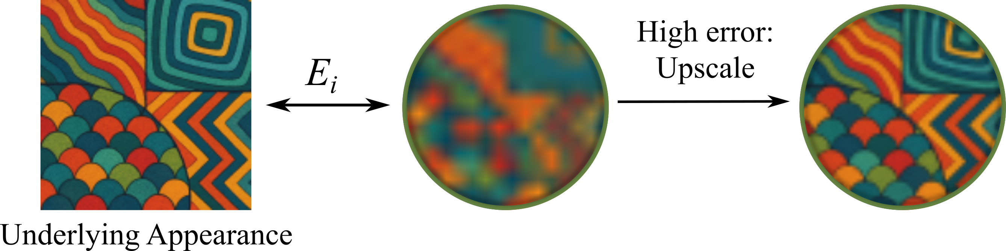
Methodology – Adaptive Texel Size – Upscaling
t ↓
k
k
Notes:
Primitives with a high such value see their textures upscaled by decreasing the paremeter t
That works for the error coming from appearance.
However, there is another source of error that cannot be solved by providing more color samples to the primitive.
And that’s the geometric error, as shown here

Slide 31
Methodology – Primitive Splitting
t ↓
k
k
Geometric Error
Independent of #color samples
Need for more primitives
Notes:
Primitives with a high such value see their textures upscaled by decreasing the paremeter t
That works for the error coming from appearance.
However, there is another source of error that cannot be solved by providing more color samples to the primitive.
And that’s the geometric error, as shown here
This flat primitive is clearly not able to reconstruct the underlying sphere
The way to fix it is by adding more primitives, to better match the geometry

Slide 32
Methodology – Primitive Splitting
High Error
Upscale
k
Notes:
Unfortunately, our system cannot identify this geometric error, since our supervision is just the RGB images.
So, our method sees a high reconstruction error and tries to fix it by upscaling the primitive, reducing its texel size.
The error remains, so our method proceeds into upscaling again.
After several iterations of this, the primitive will end up with a high texture resolution, but still high reconstruction error.
In this case, we identify the error as geometric and to solve it we proceed in splitting the primitive into smaller ones

Slide 33
Methodology – Primitive Splitting
Persisting error ⇨Geometric error
k
Notes:
Unfortunately, our system cannot identify this geometric error, since our supervision is just the RGB images.
So, our method sees a high reconstruction error and tries to fix it by upscaling the primitive, reducing its texture size.
The error remains, so our method proceeds into upscaling again.
After several iterations of this, the primitive will end up with a high texture resolution, but still high reconstruction error.
In this case, we identify the error as geometric and to solve it we proceed in splitting the primitive into smaller ones

Slide 34
Methodology – Primitive Splitting
Persisting error ⇨Geometric error
Split primitives with high texture resolution and high error E_{i}
k
Notes:
Unfortunately, our system cannot identify this geometric error, since our supervision is just the RGB images.
So, our method sees a high reconstruction error and tries to fix it by upscaling the primitive, reducing its texture size.
The error remains, so our method proceeds into upscaling again.
After several iterations of this, the primitive will end up with a high texture resolution, but still high reconstruction error.
In this case, we identify the error as geometric and to solve it we proceed in splitting the primitive into smaller ones
Then, the individual, smaller primitives can better stick to the surface finally reducing the error

Slide 35
Methodology – Primitive Splitting
Persisting error ⇨Geometric error
Split primitives with high texture resolution and high error E_{i}
Low Error
+
Coarse appearance
Downscale
k
Notes:
Then, the individual, smaller primitives can better stick to the surface finally reducing the error,
which in turn allows the downscaling strategy to kick in and make the textures coarser and coarser, saving up on parameters.

Slide 36
Results
Notes:
Moving on to results

Slide 37
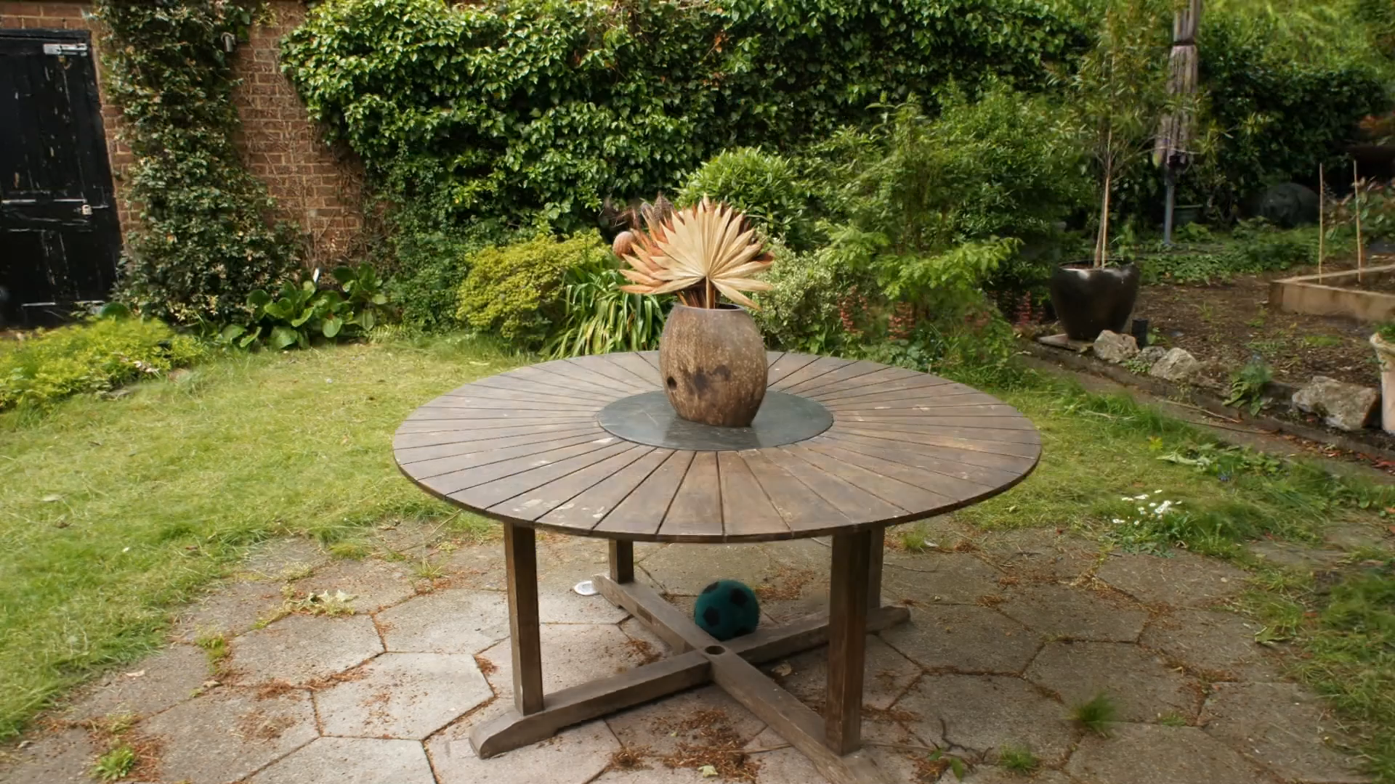
Notes:
Our method reconstructs the scenes with the high quality we are used to from 3DGS, while using way fewer, but more expressive primitives.
This is obvious when we turn off the textures and observe just the base colour

Slide 38
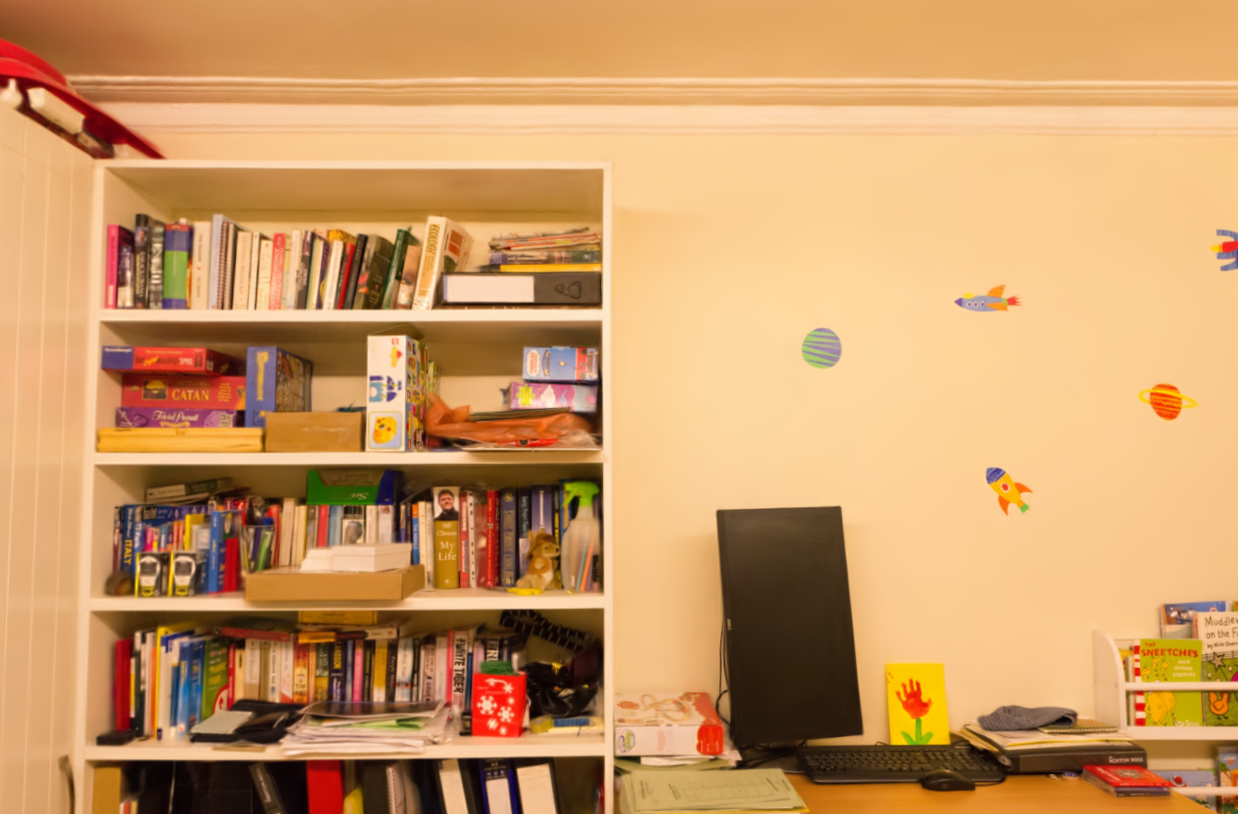
Full
Notes:
With our adaptive texel size strategy our textures match the underlying scale of details.
Here I’m gonna show you primitives with finer and coarser textures by filtering based on the scalar parameter t

Slide 39
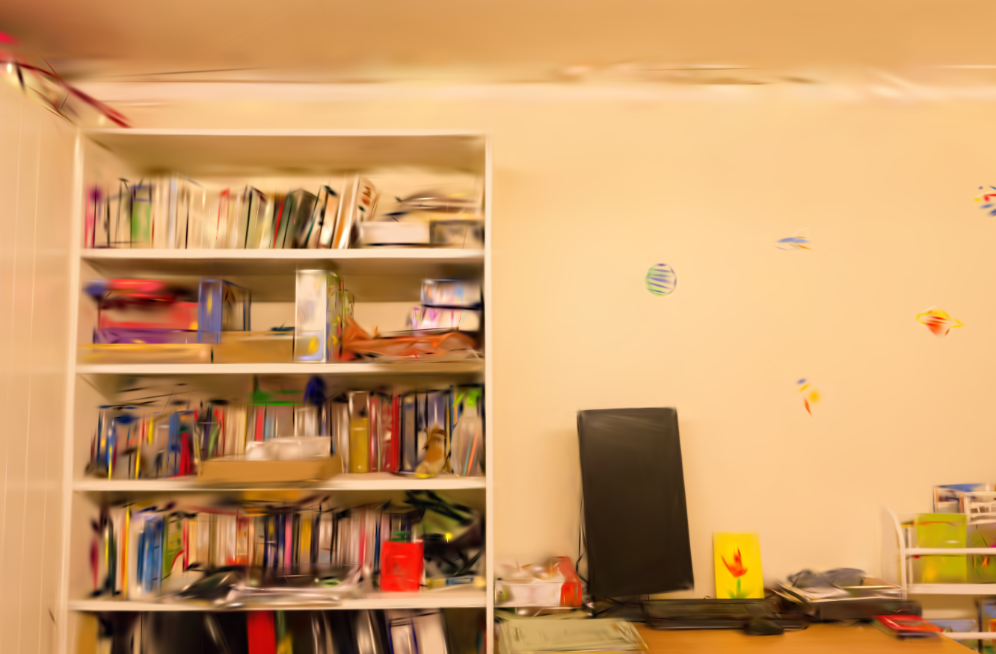
Coarse Appearance
Notes:
Notice how the coarse primitives capture the general structure and low frequency details, like the wall,

Slide 40
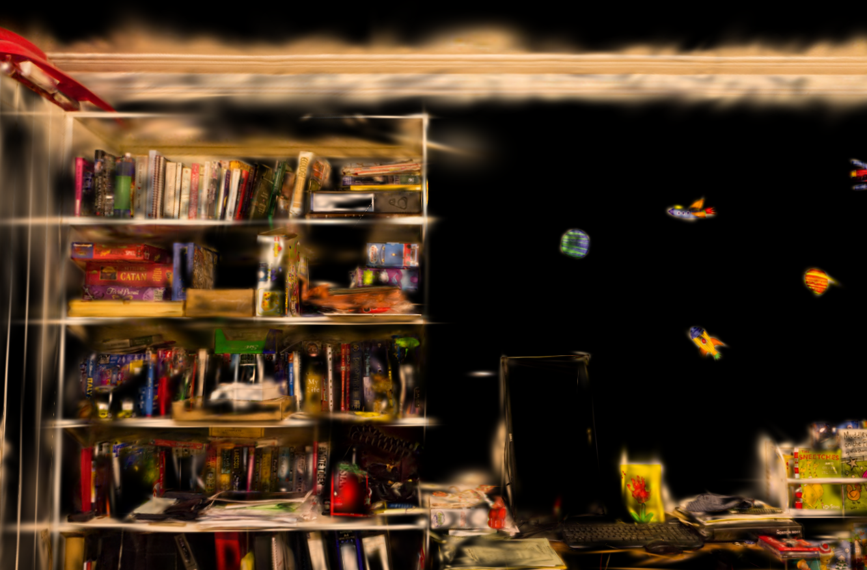
Fine Appearance
Notes:
While the fine ones capture high frequency details like the covers of the books and completely miss the wall

Slide 41


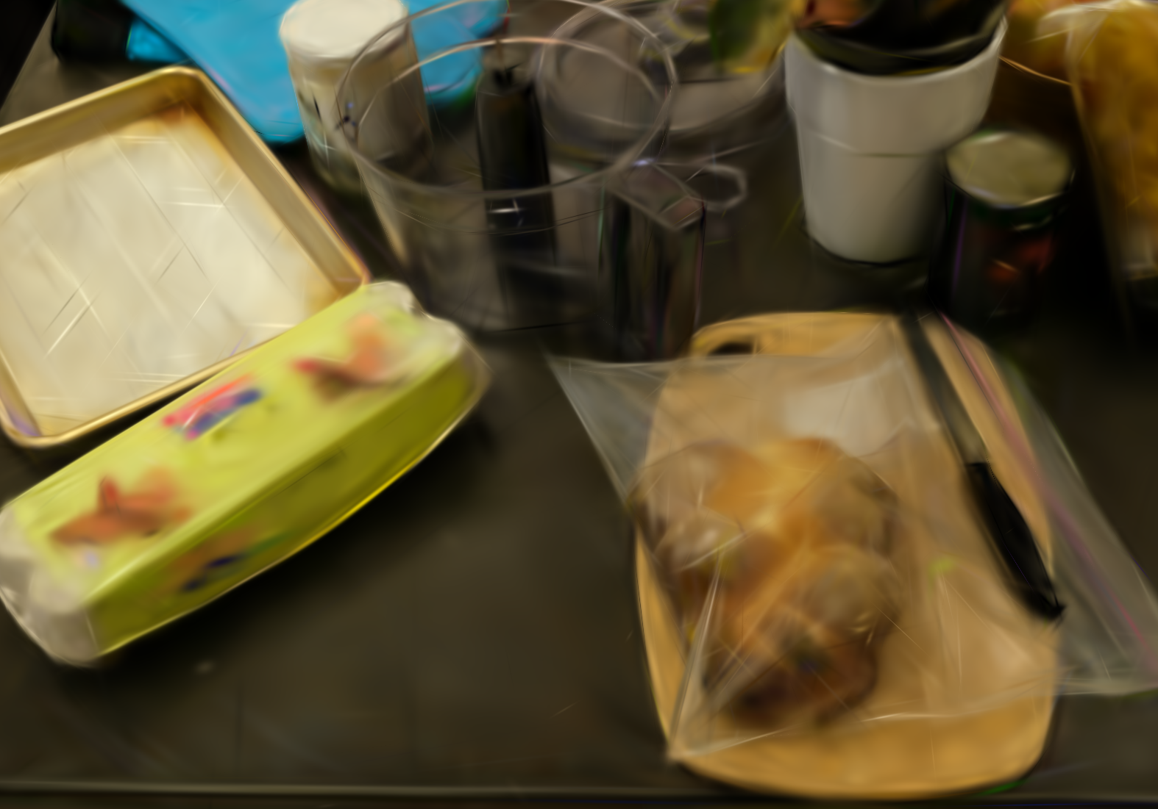

40k Primitives
160k Primitives
Texture On
Texture Off
Notes:
Our technique is also versatile enough to produce good results even with a limited primitive budget.
As you can see, even when limiting the number of primitives to 40k we get almost identical results to when using 160k primitives.
Of course, under the hood, this means that in the 40k case, the primitives are more expressive by having way more color samples
as seen on the bottom row where textures are switched off

Slide 42
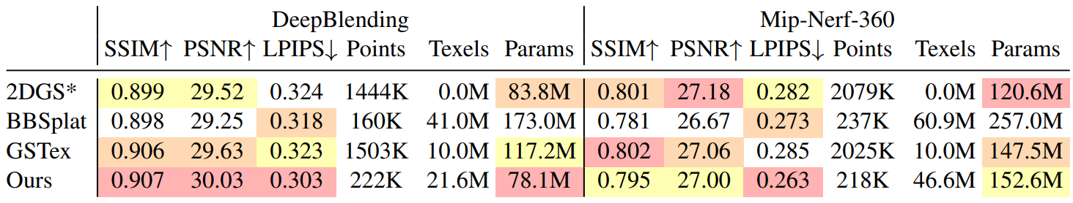
Quantitative Comparisons – Default Settings
Notes:
As for quantitative comparisons
We offer competitive or better performance than the baseline and other texturing methods
As expected we have way fewer primitives than the baseline, as our primitives carry more color samples.
Also, in terms of #of parameters we’re lower than the other methods in DeepBlending scenes,
while way lower than bbsplat but similar to the others in MipNeRF360, which has several outdoor scenes with fine geometric details like grass, that are very challenging to represent with a low primitive count.
(Note that we didn’t perform any per-scene or per-dataset finetuning in our hyperparameters.)

Slide 43
Quantitative Comparisons – Default Settings
Notes:
Compared to other methods,
We offer competitive or better performance than the baseline and other texturing methods
As expected we have way lower primitives than the baseline, as our primitives carry more color samples.
Also, in terms of #of parameters we’re lower than the other methods in DeepBlending scenes,
while way lower than bbsplat but similar to the others in MipNeRF360, which has several outdoor scenes with fine geometric details like grass, that are very challenging to represent with a low primitive count.
(Note that we didn’t perform any per-scene or per-dataset finetuning in our hyperparameters.)

Slide 44
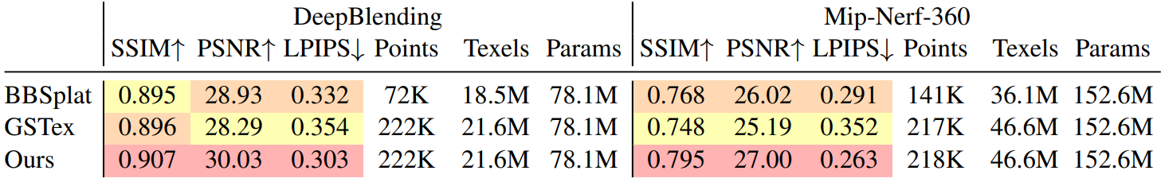
Quantitative Comparisons– Same #parameters
Notes:
In an attempt to compare the texturing techniques in a same basis,
We ran a same number of parameters
To do that, for Gstex we set the primitive count of the pretrained 2DGS model to be the same as ours and allocate the same texel budget us ours.
As BBSplat imposes a fixed ratio between texels and points, by having primitives of 16x16 resolution, we compute just the number of primitives
Our technique comes clearly on top

Slide 45
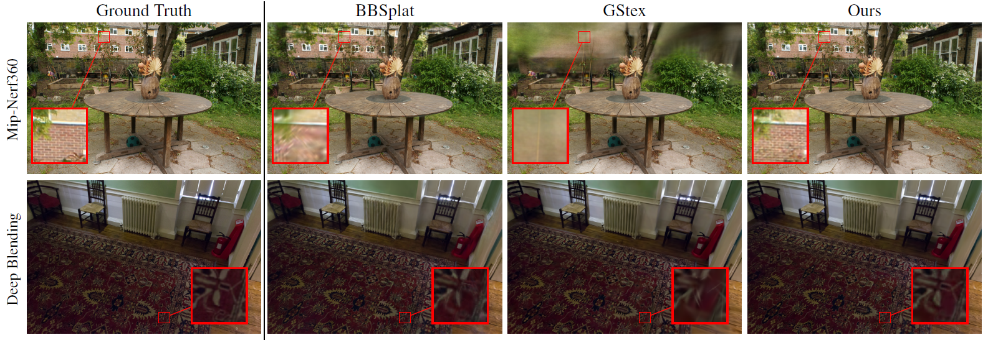
Qualitative Comparisons – Same #parameters
Notes:
Looking at the images, we can see that not using a variable texture resolution for BBSplat poses a problem, as it cannot allocate color samples where they are actually needed.
Also, Gstex, by using a converged 2DGS model for its initialization of geometry, is too dependent on it and struggles to recover when the provided geometry is not good enough

Slide 46
Limitations – Future Work
Limitations
Anti-aliasing
Virtuous vs vicious cycle
Slower due to per-ray texture querying
Future Work
Use of dedicated hardware
Compression/mip-mapping
Notes:
Some limitations of our work is that we don’t actually deal with anti-aliasing and prefiltering. Our choice of texel size just makes aliasing effect less pronounced
The virtuous cycle between primitive spawning and adaptive texel size can turned vicious leading to OOM.
It is slower to train and render than the baseline, due to per-ray texture querying
For future work, we propose the use of dedicated hardware at rendering time
And the exploration of compression mip-mapping after convergence

Slide 47

This project was funded by the ERC Advanced grant No 101141721 NERPHYS. We thank Adobe, NVIDIA, and the OPAL infrastructure from Université Côte d’Azur.
Thanks a lot for your attention!
Questions?
Notes:
Thanks a lot for listening and I’m happy to answer your questions

