Slide 1




Splat and Replace 3D Reconstruction with Repetitive Elements
SIGGRAPH 2025
Nicolás Violante^{1,2,3} Andreas Meuleman^{1,2} Alban Gauthier^{1,2}
Fredo Durand⁴ Thibault Groueix³ George Drettakis^{1,2}
1
2
3
4

Slide 2
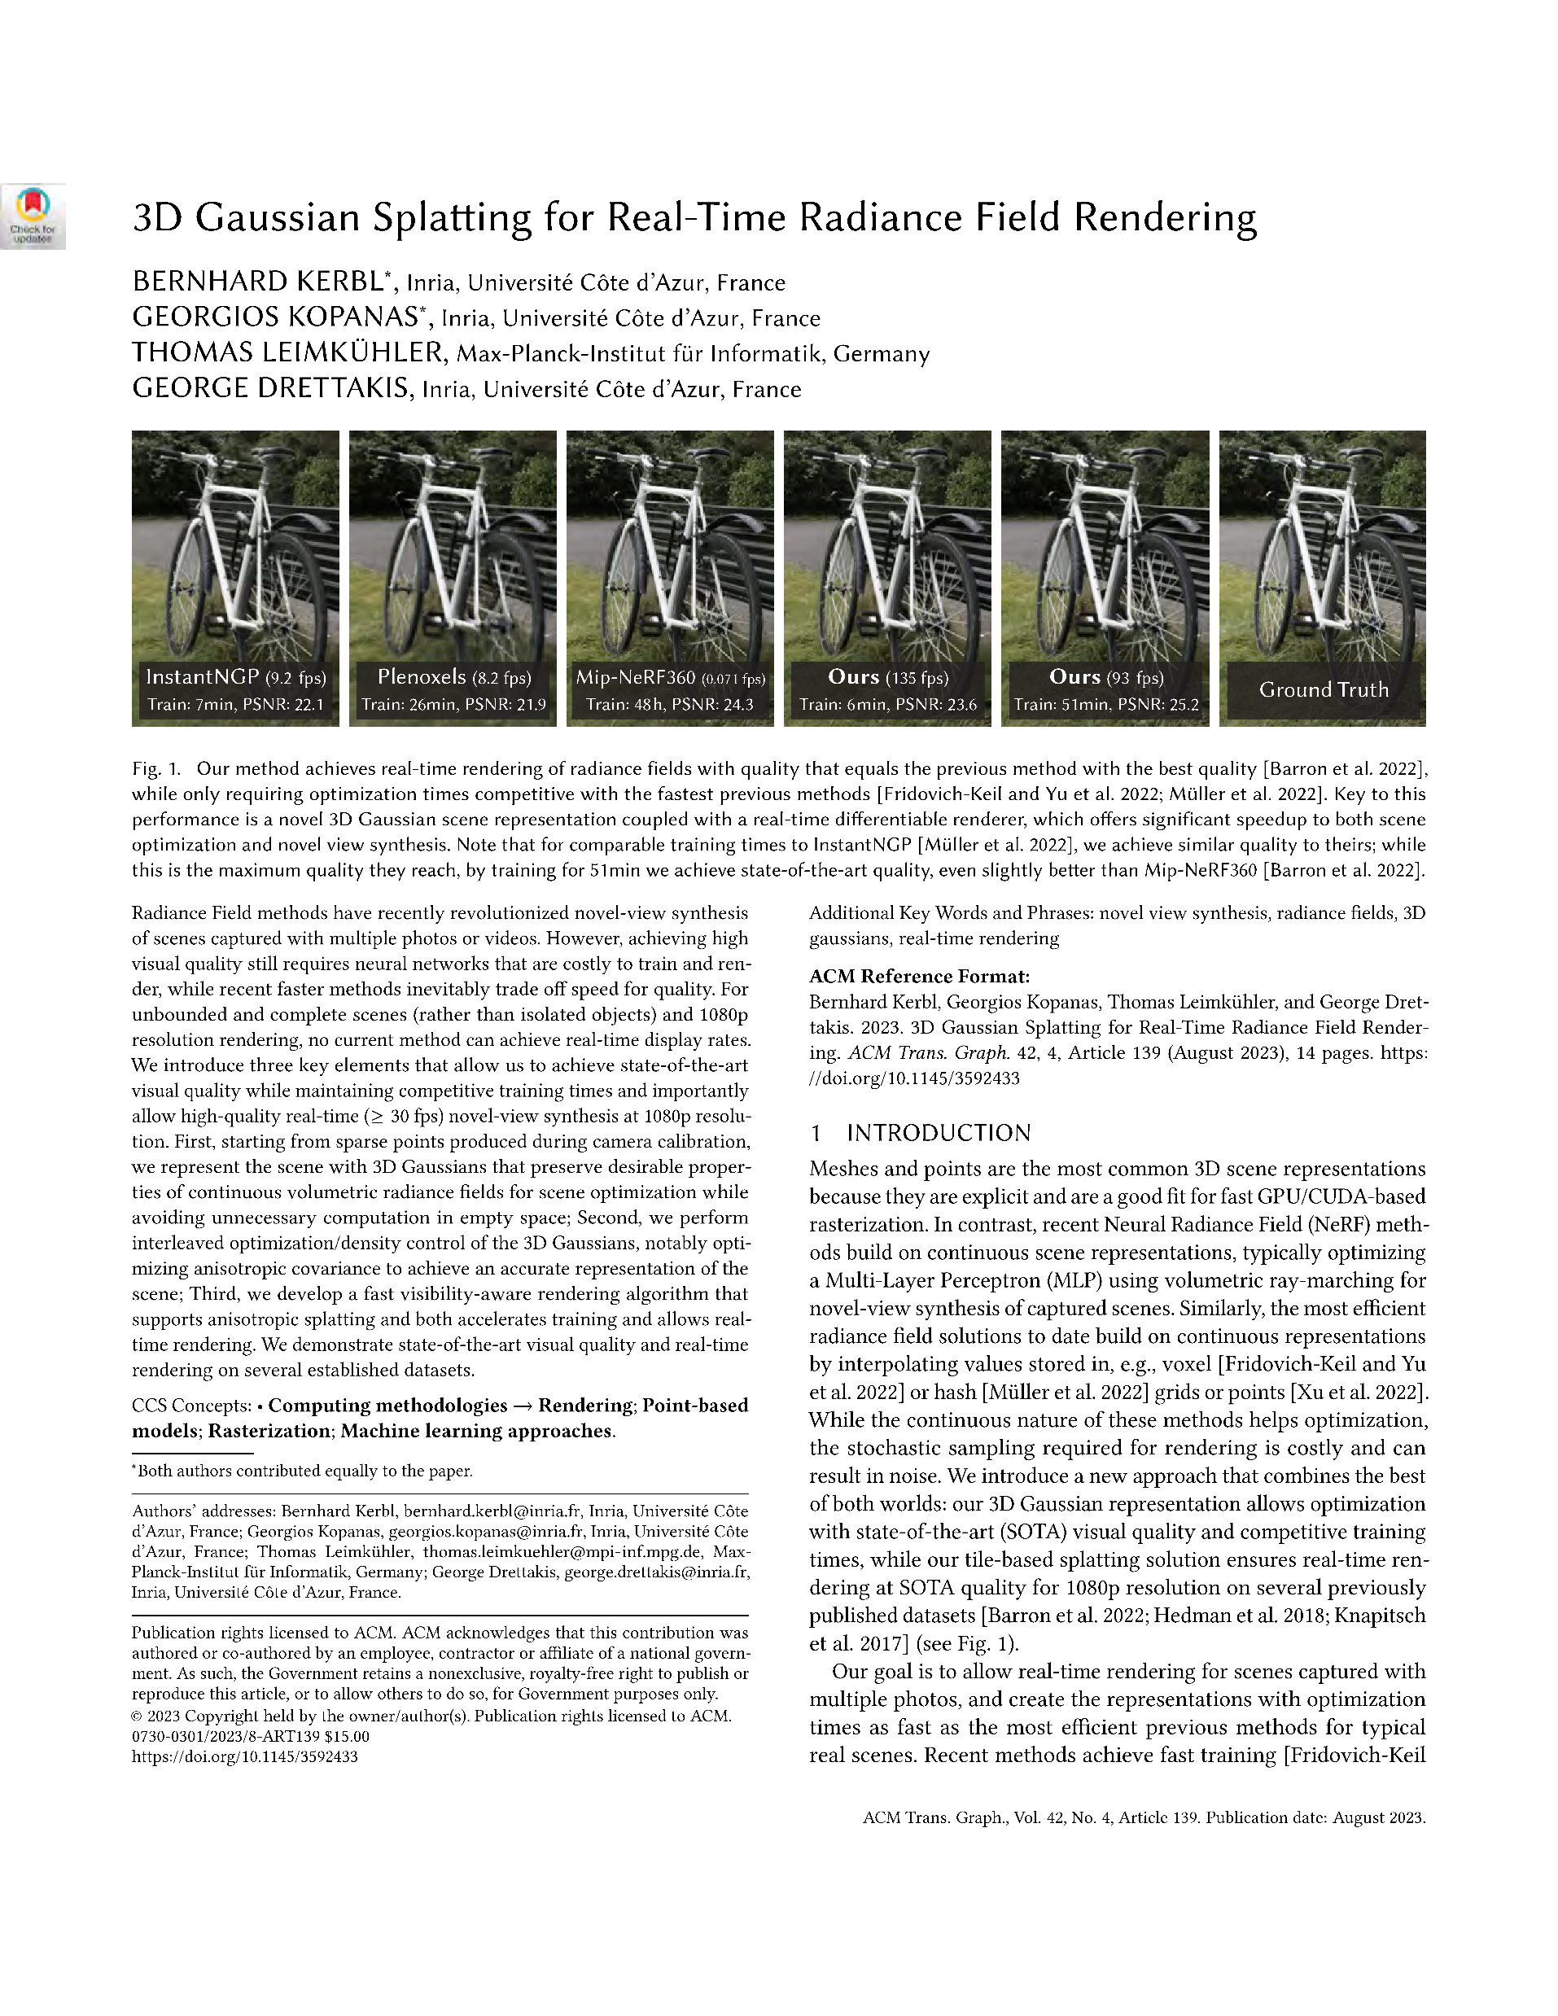
Gaussian Splatting
“3D Gaussian Splatting for Real-Time Radiance Field Rendering” SIGGRAPH 2023, B. Kerbl, G. Kopanas, T. Leimkühler, G. Drettakis
Notes:
I will start with some background.
3D Gaussian Splatting, introduced by Kerbl et al in 2023 from our group, obtains high quality reconstruction from posed images, that enables novel synthesis

Slide 3
Notes:
A scene is represented a set of 3D Gaussians with different scales, orientantion and opacity that cam be efficiently rasterized for real-time rendering.
To render the color of a pixel, the gaussians are splat, then the color of each on is sampled and alpha-blender along the ray

Slide 4
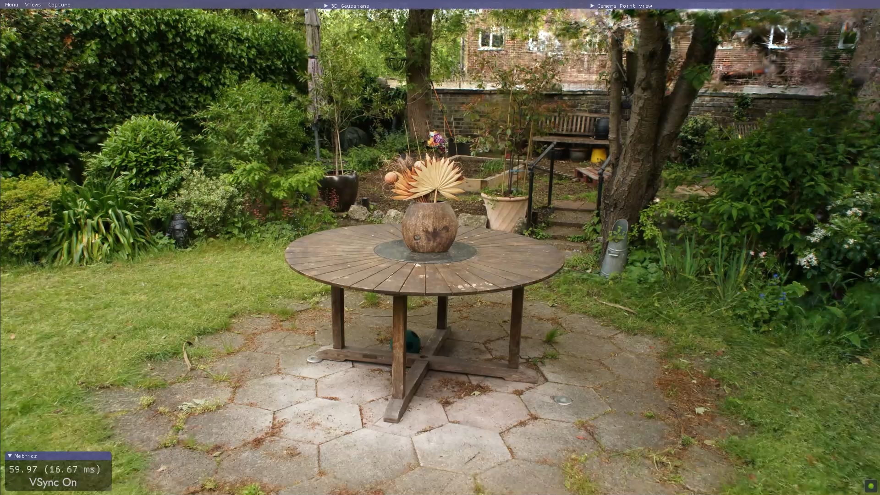
3DGS is great at interpolation
Notes:
3DGS is great at interpolation.
Here we have a MipNeRF 360 scene with a dense 360 capture, and we can see how well the Gaussians represent the scene and we can navaigte the scene and produce high qulity novel views

Slide 5
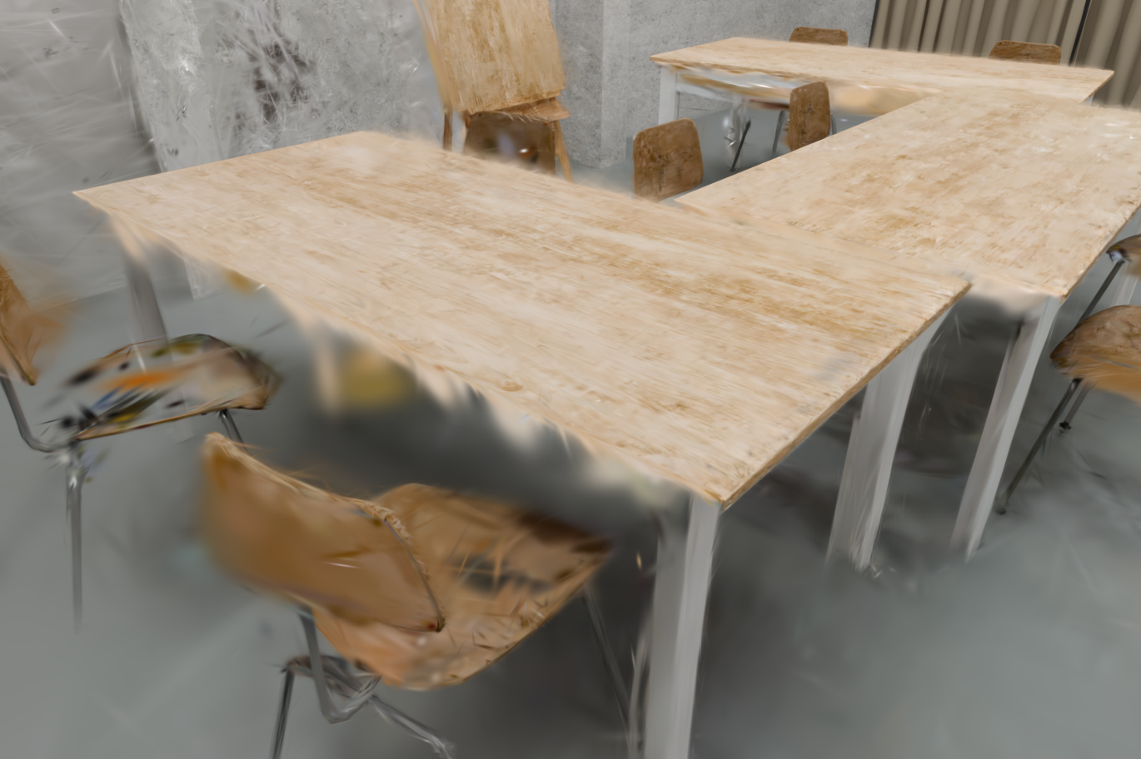
… but struggles with extrapolation
Notes:
However, 3DGS struggles with extrapolation, with artifacts due to
- occlusions
- lack of training views in some regions

Slide 6
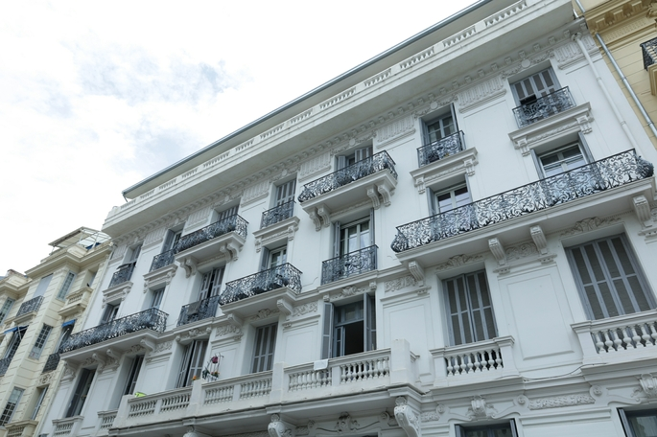
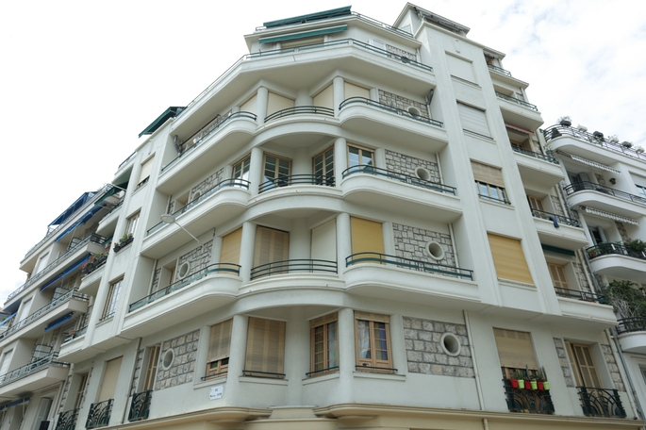
Scenes often have repetitions
Notes:
To tackle this, our main observation is that many scenes have repetitions that we can use to improve the reconstruction in problematic areas.
For example in building facades we havee repetitive railings, windows, and other elements

Slide 7
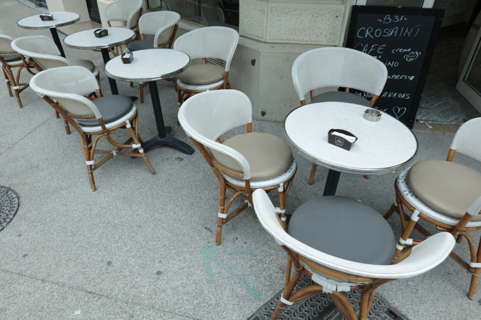
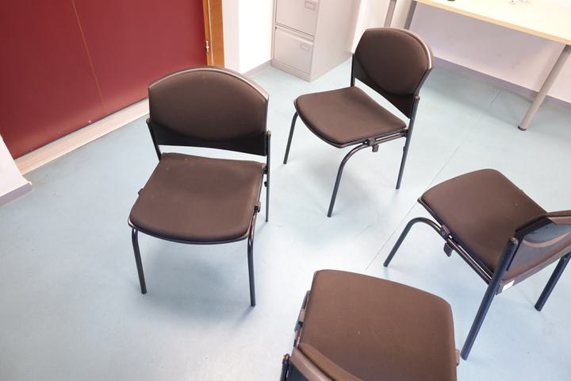
Scenes often have repetitions
Notes:
We also also have repetitions in other scenes with furniture such as tables, chairs

Slide 8
Method
Notes:
I'll briefly go over the main steps of our method tand then explain each one in more detail

Slide 9
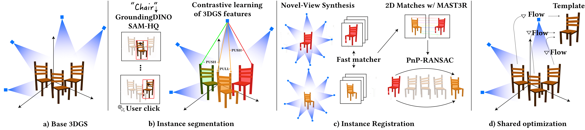
Notes:
- First we train a base 3DGS reconstruction
MARK 2:30 MIN

Slide 10
Notes:
- Second, the segment the repetitions using instance segmentation based on contrastive learning from 2D masks

Slide 11
Notes:
- Third, we register the instances. To align them, we introduce use dense matching on novel views

Slide 12
Notes:
- And finally we merge the repetitions into a single shared representation or template and firth optimize
Each repetitions receives information from all other repetions, improving the reconstruction quality.
Give front/back example
MARK 2:30 MIN

Slide 13
Base 3DGS
Monocular depth
Exposure Adjustment
L₁ on scale and opacity
Notes:
Since our case is more challenging, we add vanilla 3DGS
Monocular depth supervision to reduce floaters
Exposure adjustment for each frame to account color shift due to exposure
Also include L1 reg on scale and opacity to improve segmentation, details in the paper

Slide 14
Extending 3DGS for Segmentation
Add new feature per Gaussian primitive
Get 2D masks
Train features with contrastive learning
Notes:
Follwing recent works, we extend 3DGS by adding a bnew feature oer gaussian.
Features can be rasterize same way as the RGB colors, during training, gradients from the pixel features flow to each Gaussian primitive that contributed to the pixel.
We learn the features by
Getting 2D masks
Training the features

Slide 15
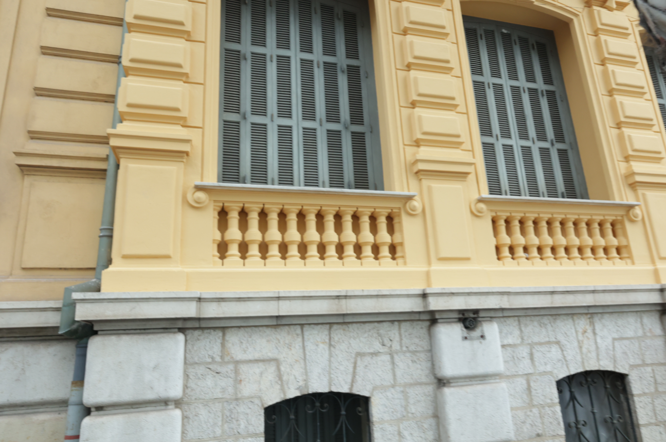
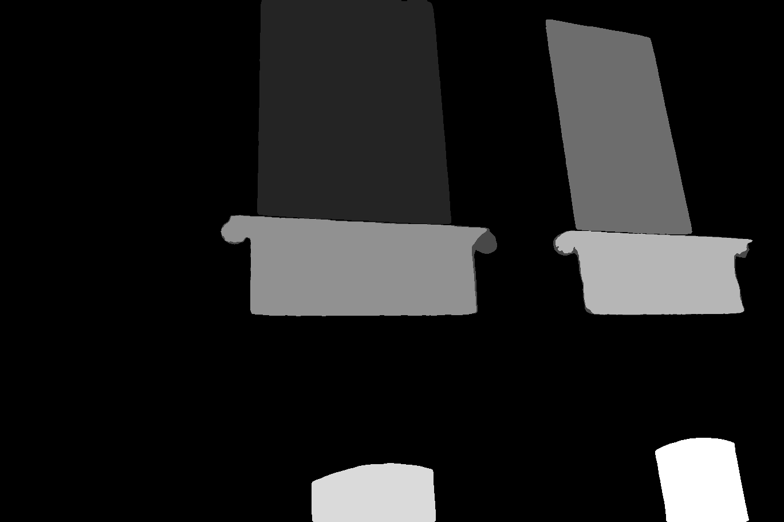
2D Masks from Text Queries
Text queries: “window”, “railing”
Notes:
To get the 2D masks, we use a Segment Anything Model based on text queries.
Explain example

Slide 16
Extending 3DGS for Segmentation
Add new feature per Gaussian primitive
Get 2D masks
Train features with contrastive learning
Notes:
In practice we use features of dimension 16, we can render the features just like the RGB colors, and backpropagate from rendered features

Slide 17
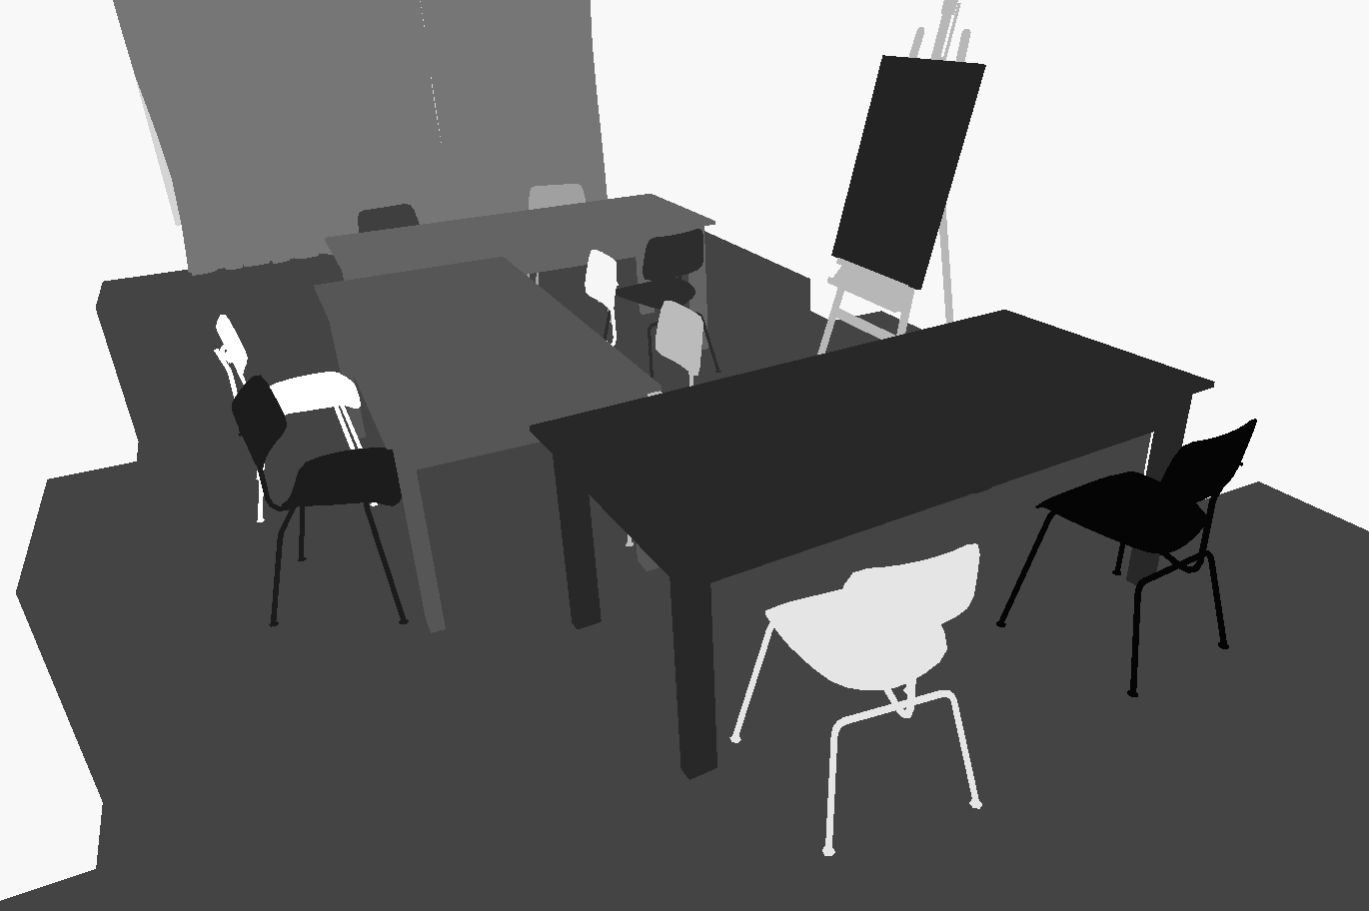
Learning Contrastive Features
Sample 2 pixels
If pair in same mask:
pull features
If pair in different mask:
push features
Notes:
To learn the per Gaussian features, we first rasterize them an get one feature per pixel
The gradient flow from the pixel features for each Gaussian primitive
MARK 4 MIN

Slide 18
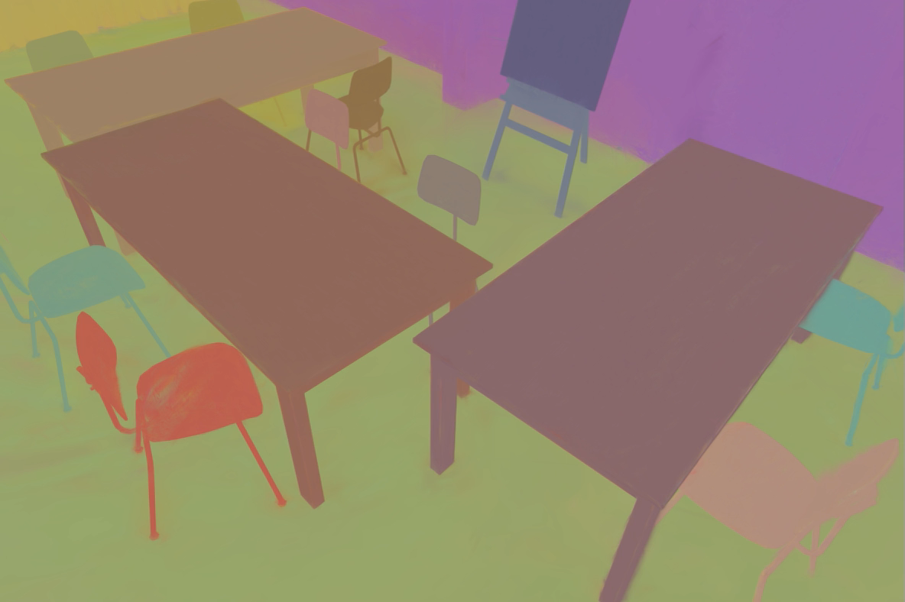
Rendering Contrastive Features
Notes:
Here we visualie the features after contrastive training

Slide 19
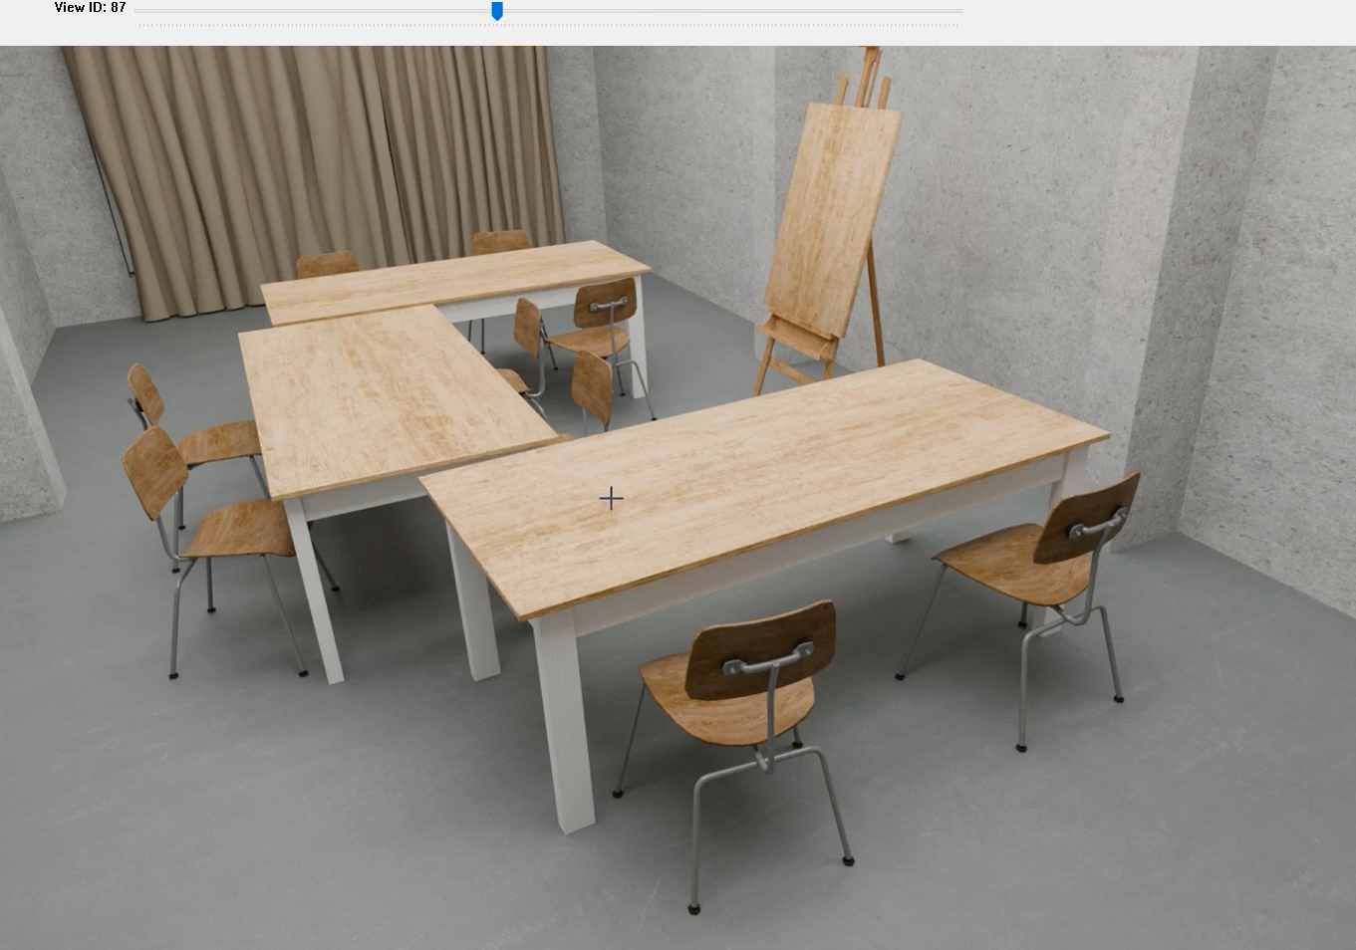
Click to Segment Repetitions
Notes:
To group the repetitions of the same type together, we rely on user interaction. The user needs to click each repetition just once in any view (just one click)
The 3D segmentation is performed by comparing the clicked feature with the feature of each primitive.
MARK 5 min

Slide 20
How to align Gaussians?
Challenges:
Many Gaussians behind surface
Varying spatial density
We can render new views for better matching!
Notes:
Once we segment the repetitions, we need to align them
The challenges here are:
Gaussian behind
density
As a result the views we have are not good enough for matching
This makes traditional 3D registration methods desgined for point clouds from scans fai

Slide 21
Registration from novel views
Input: 2 instances
1. Find k candidate pairs of views
2. Robust dense 2D matching
3. Solve from 2D-3D correspondences
Output: R, T
Notes:
Here we introduce Registrarion from Novel Views
MARK 6 MIN

Slide 22
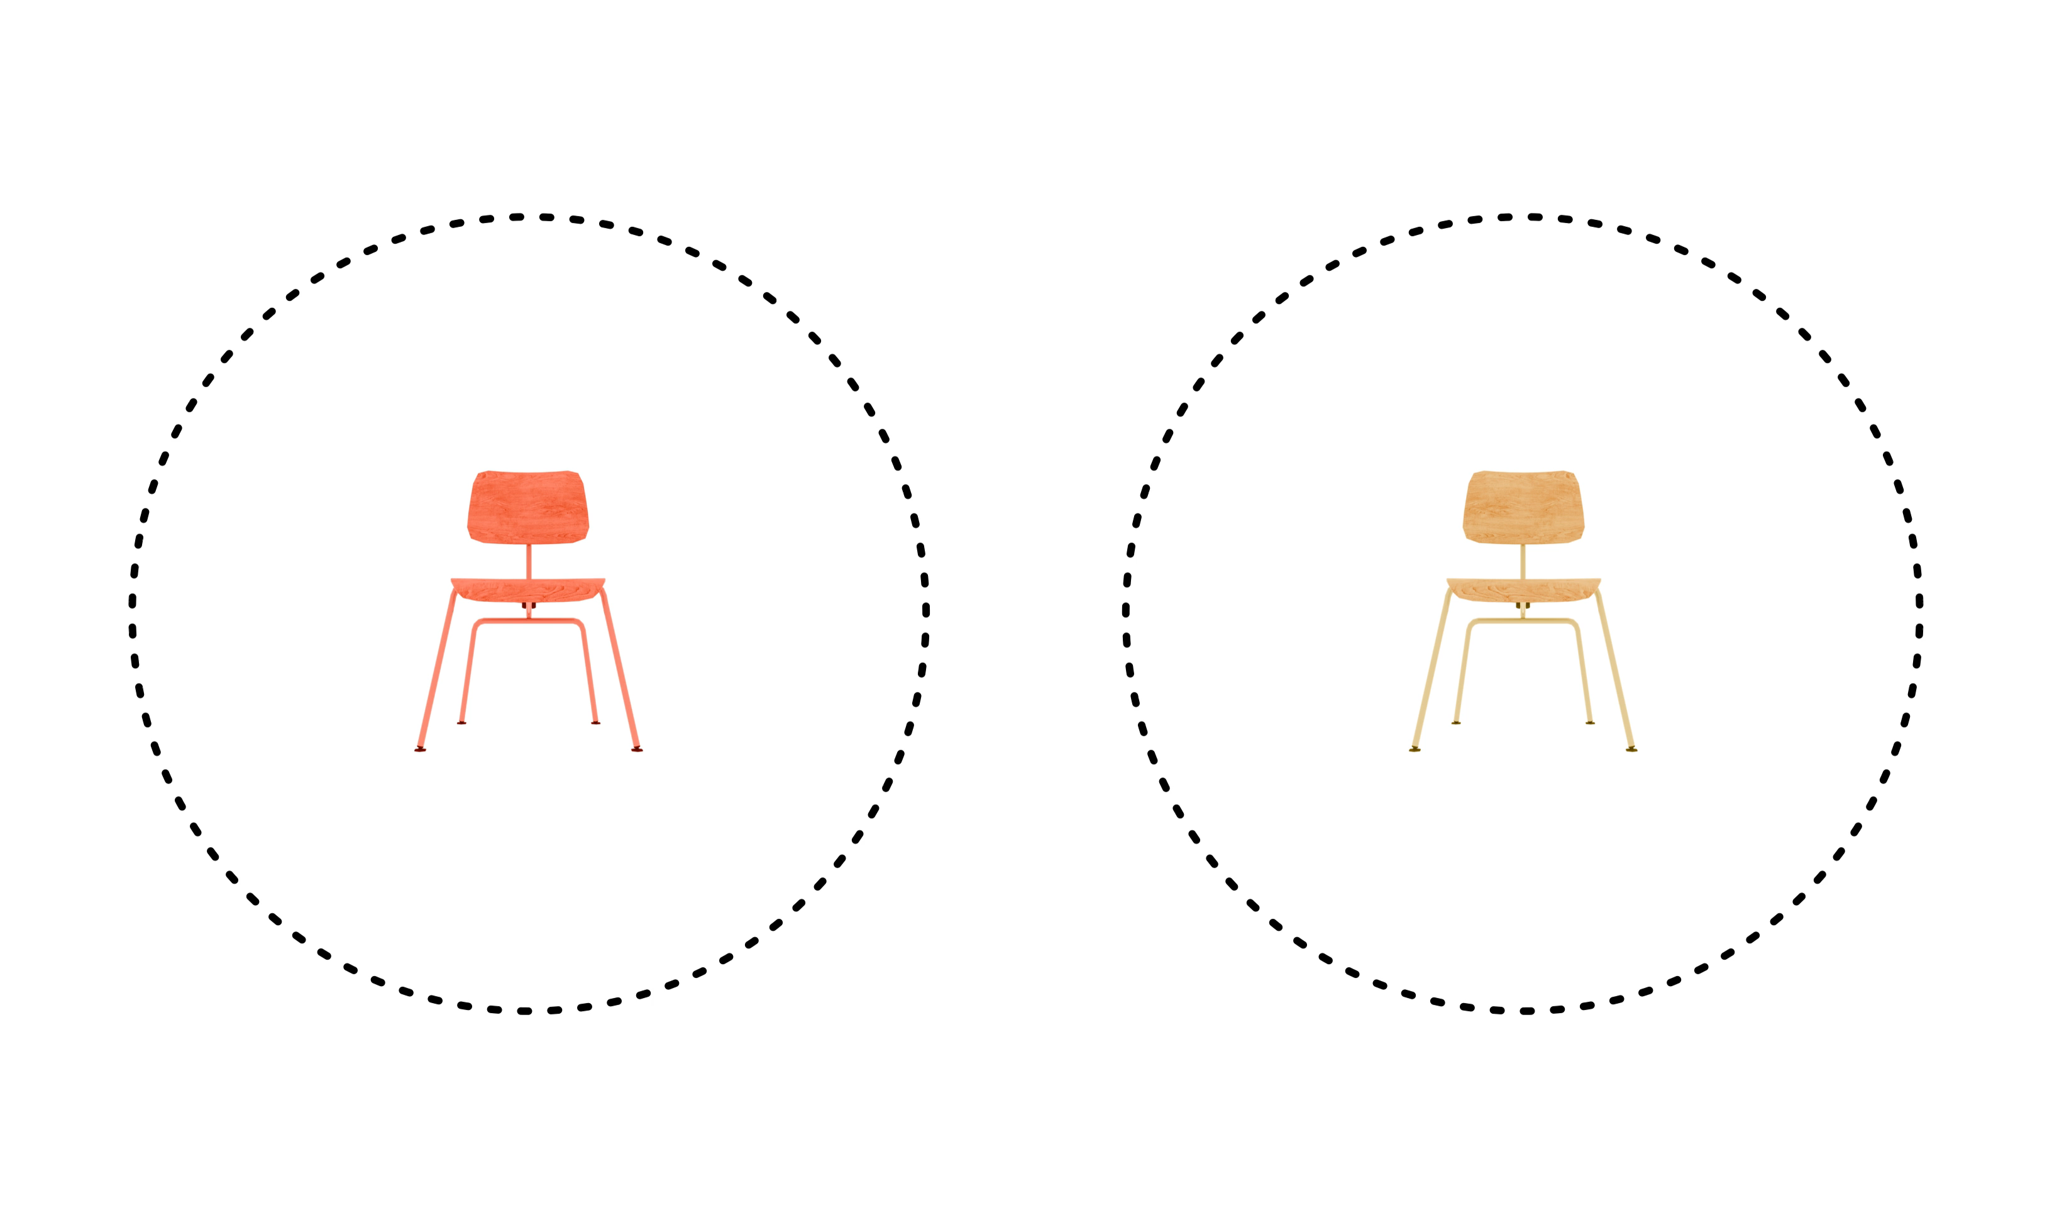
Find k candidate pairs of views
Notes:
To select k candidate pairs of views, we render novel views in a sphere around the instances.
Note that rendering novel views after segmentation removes the occlusion caused by other elements in the scene

Slide 23
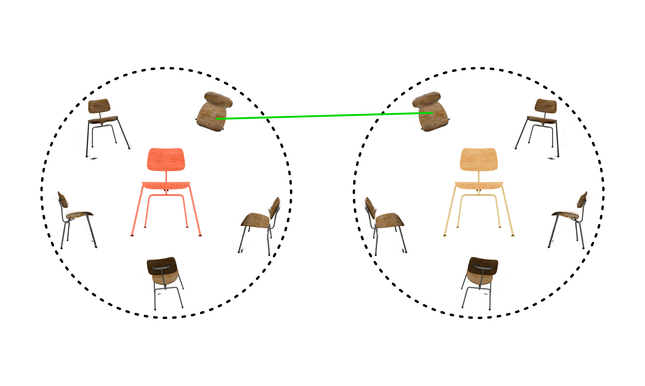
Find k candidate pairs of views
Notes:
Then we find the candidates using a fast sparse matching network
Not accurate first but good to select candidates for the accurate (but slow) dense matcher

Slide 24
Registration from novel views
Input: 2 instances
1. Find k candidate pairs of views
2. Robust dense 2D matching
3. Solve from 2D-3D correspondences
Output: R, T

Slide 25
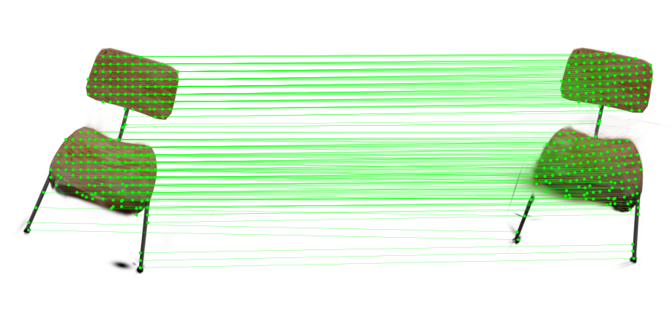
Robust dense 2D matching
Notes:
We obtain dense matches using Mast3R
MARK 7 MIN

Slide 26
Registration from novel views
Input: 2 instances
1. Find k candidate pairs of views
2. Robust dense 2D matching
3. Solve from 2D-3D correspondences
Output: R, T

Slide 27
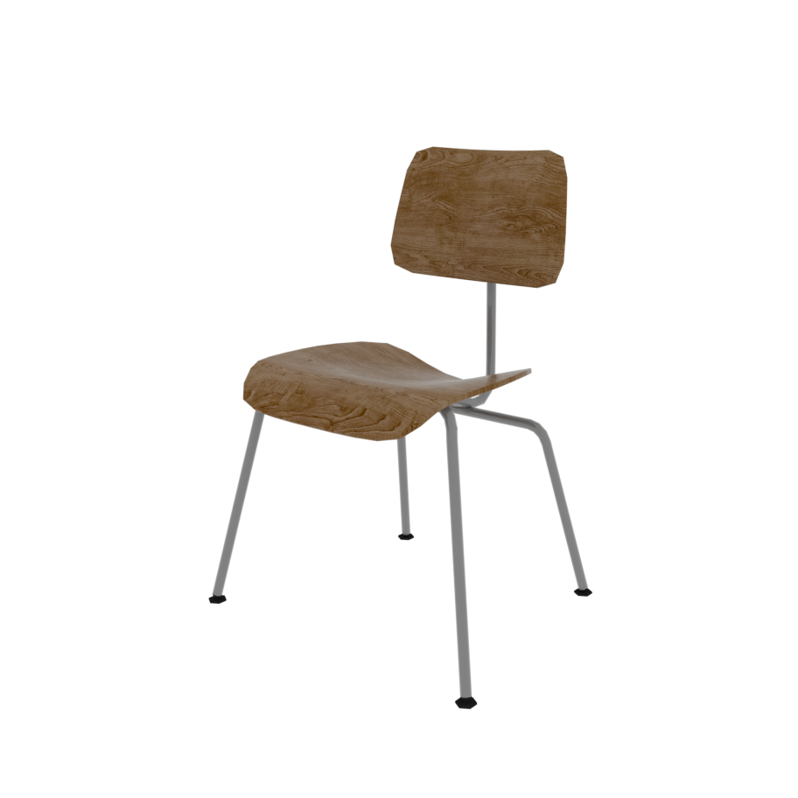
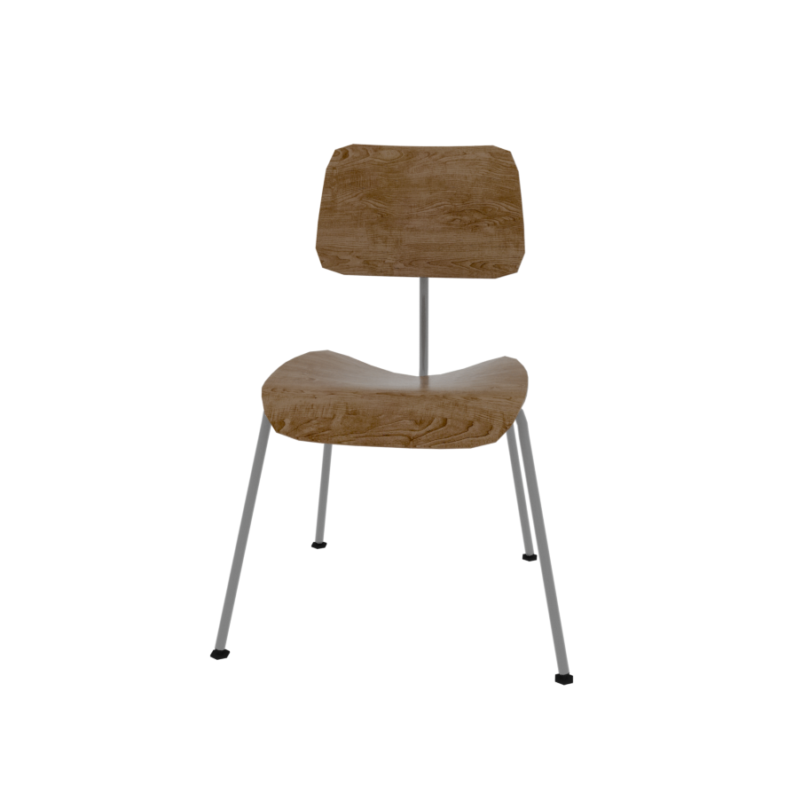
Notes:
We lift the matches to 3D

Slide 28
Notes:
Lift to 3D

Slide 31
Use novel views for matching and instance registration
Notes:
First takeaway
- we create the views we need for matching
MARK 7 30 MIN

Slide 32
Shared Representation for Repetitions
Create template
Merge all instances
Receive gradients from all instances
Individual color offset
Notes:
Here we introduce a Shared Representation for Repetitions.
- We create a templte by mering all instances
- Each instance recieves fradient from all the other instances
- We also include a color offset to account appearence variation of each instance

Slide 33
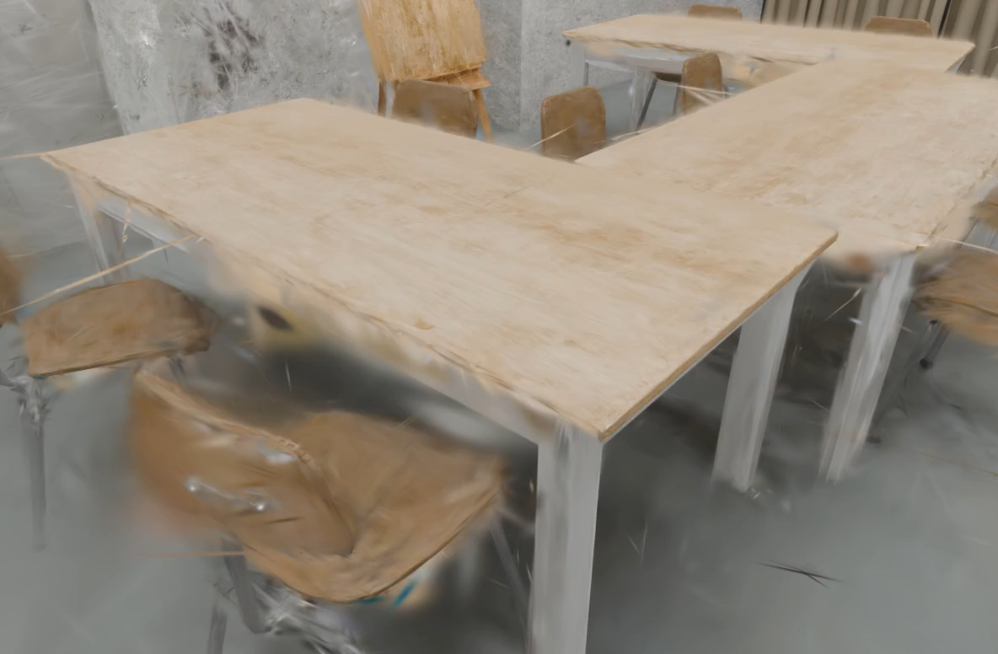
Finetuning the Shared Representation

Slide 34
Optimize a shared representation for repetitions
Notes:
Second takeaway
MARK 8 30 MIN

Slide 35
Results

Slide 36
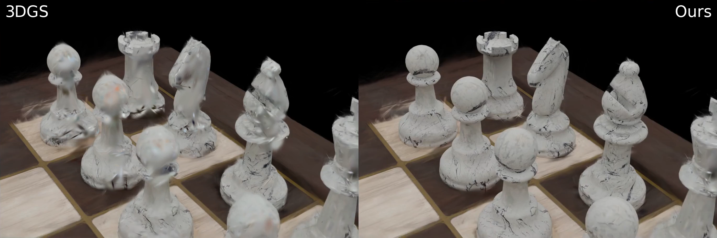
Notes:
We use synthetic scenes to have quantitative metrics, more details in the paper

Slide 37
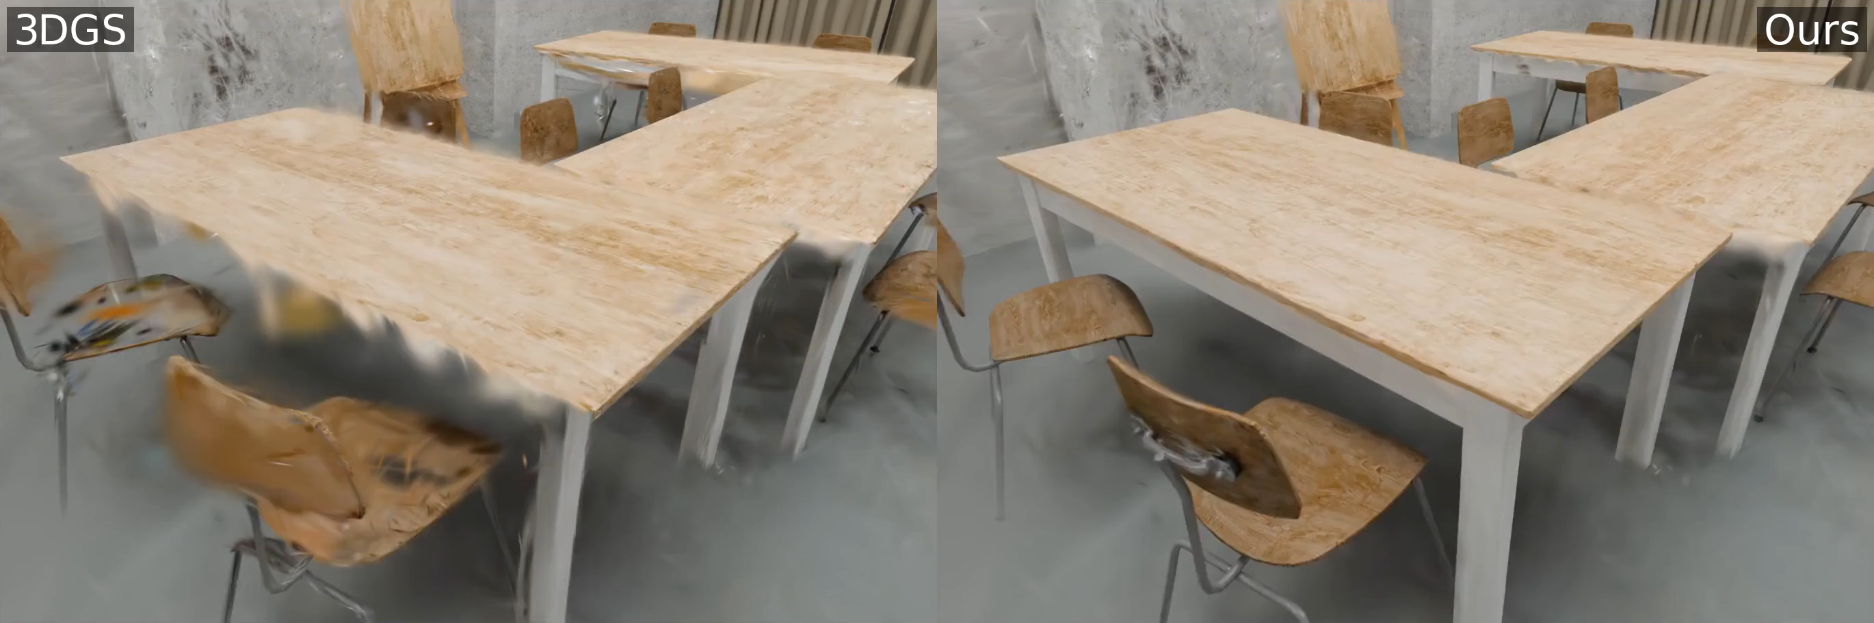

Slide 38
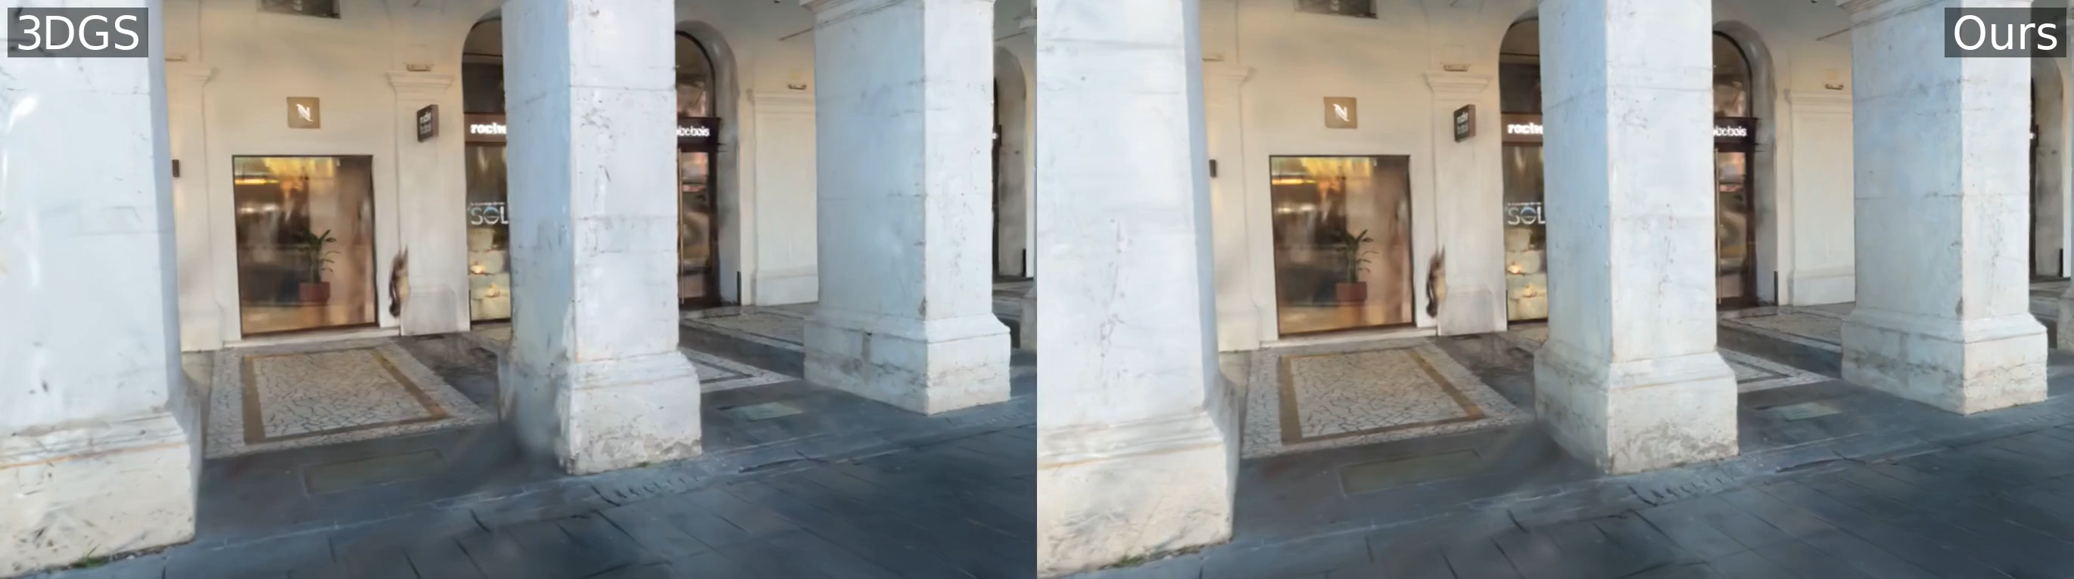

Slide 39
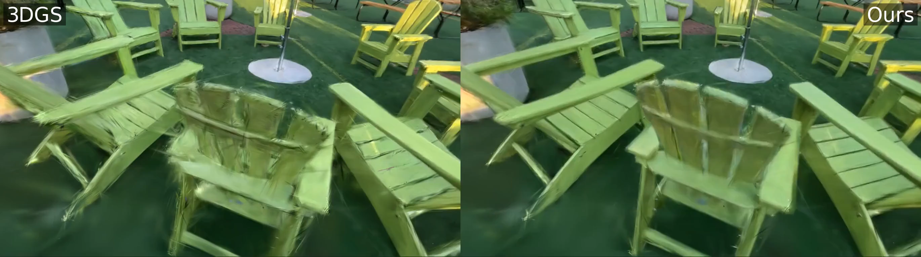
Notes:
DL3DV
MARK 9 30 MIN

Slide 40
Summary
Use repetitions to improve reconstruction
Novel views for matching and registration
Shared representation for repetitions

Slide 41

Splat and Replace 3D Reconstruction with Repetitive Elements
Scan for web project!
SIGGRAPH 2025
Nicolás Violante^{1,2,3} Andreas Meuleman^{1,2} Alban Gauthier^{1,2}
Fredo Durand⁴ Thibault Groueix³ George Drettakis^{1,2}
1
2
3
4

